Slide 1












Slide 6

CONTEXT DIAGRAM

Slide 7

CONTEXT DIAGRAM
Give Feedback
System For Collection of Users Experience Data
USER
Perform Speed Test
Modify Privacy Settings
Prompt Feedback Form
Show live Coverage maps
Compare Operators
Provide Performance Logs
Give Feedback

Slide 8

DATA FLOW DIAGRAM

Slide 9

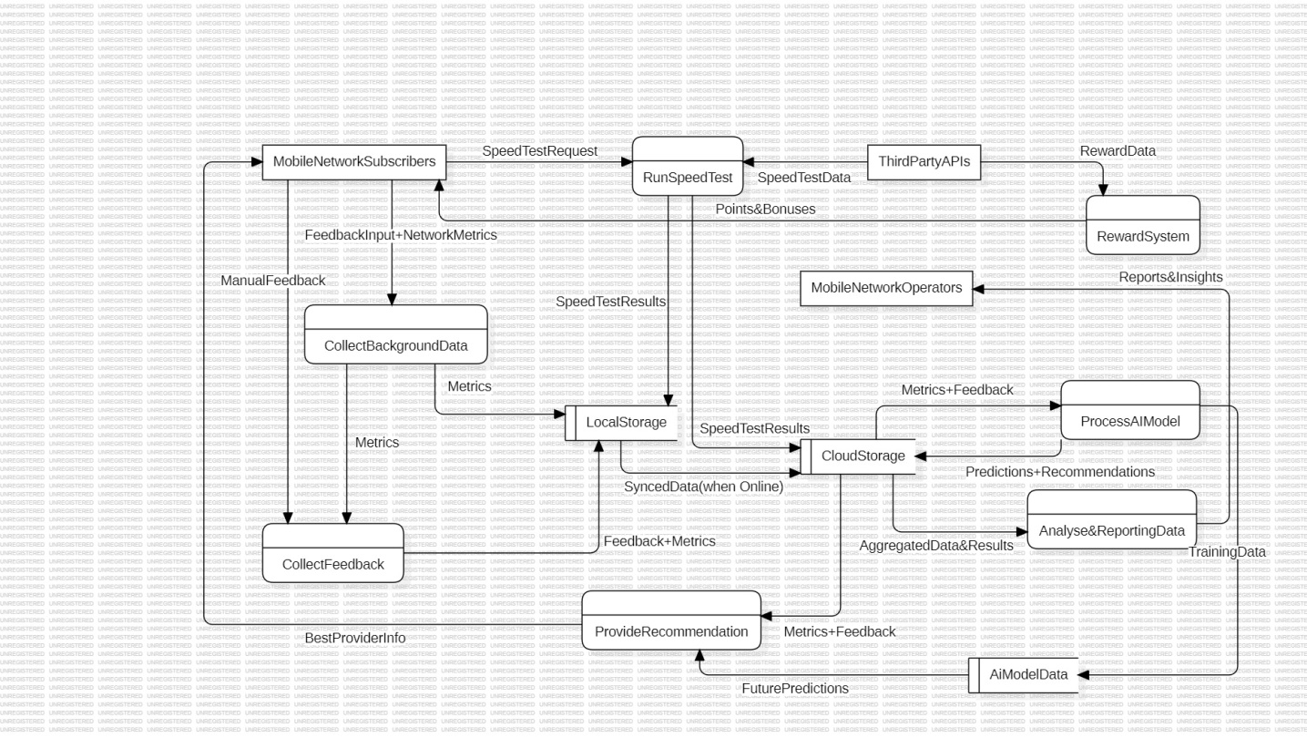
DATA FLOW DIAGRAM

Slide 10

USE CASE DIAGRAM

Slide 11

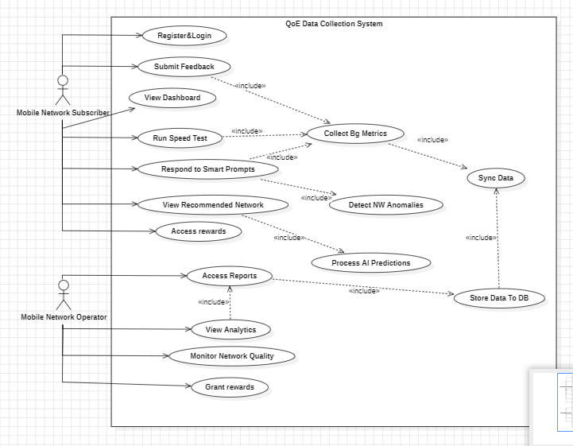
USE CASE DIAGRAM

Slide 12

SEQUENCE DIAGRAM

Slide 13

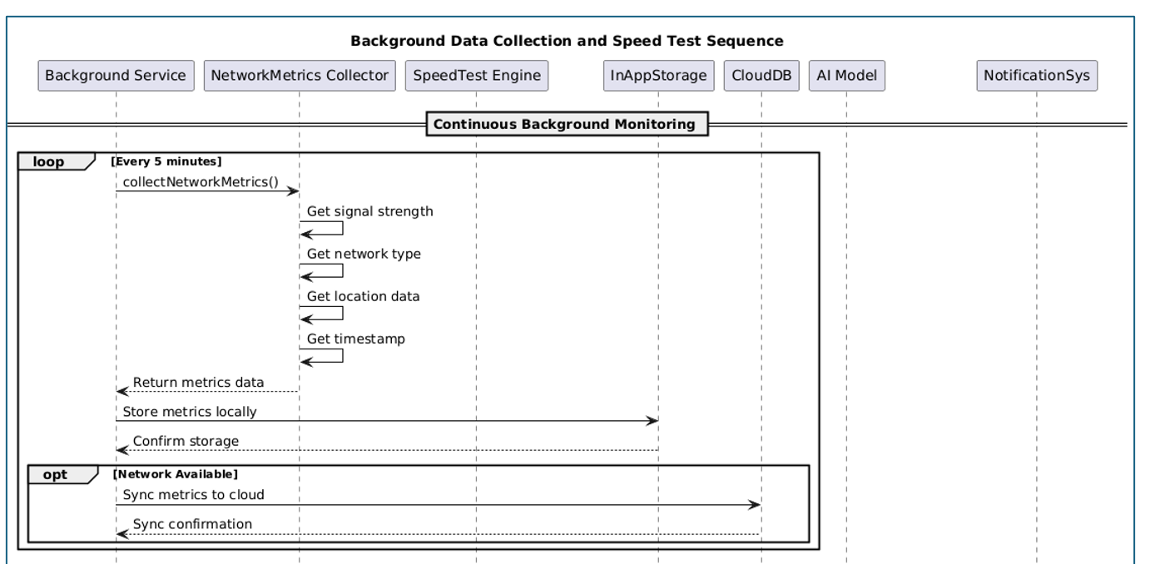
SEQUENCE DIAGRAM 1/2

Slide 14
SEQUENCE DIAGRAM 2/2

Slide 15

CLASS DIAGRAM

Slide 16

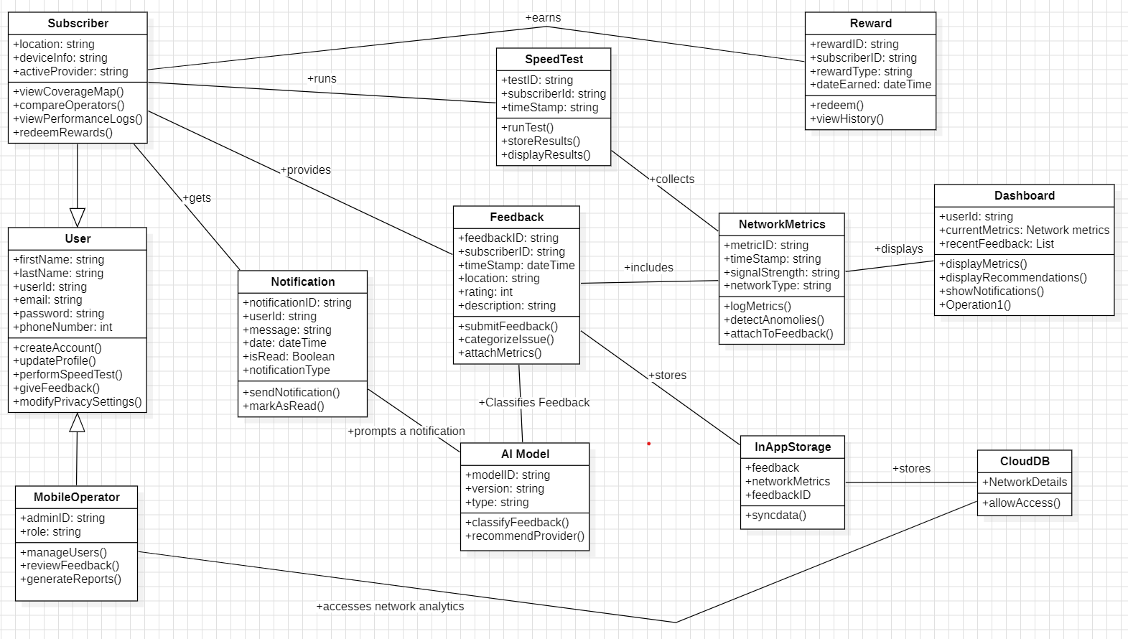
CLASS DIAGRAM

Slide 17

DEPLOYMENT DIAGRAM

Slide 18

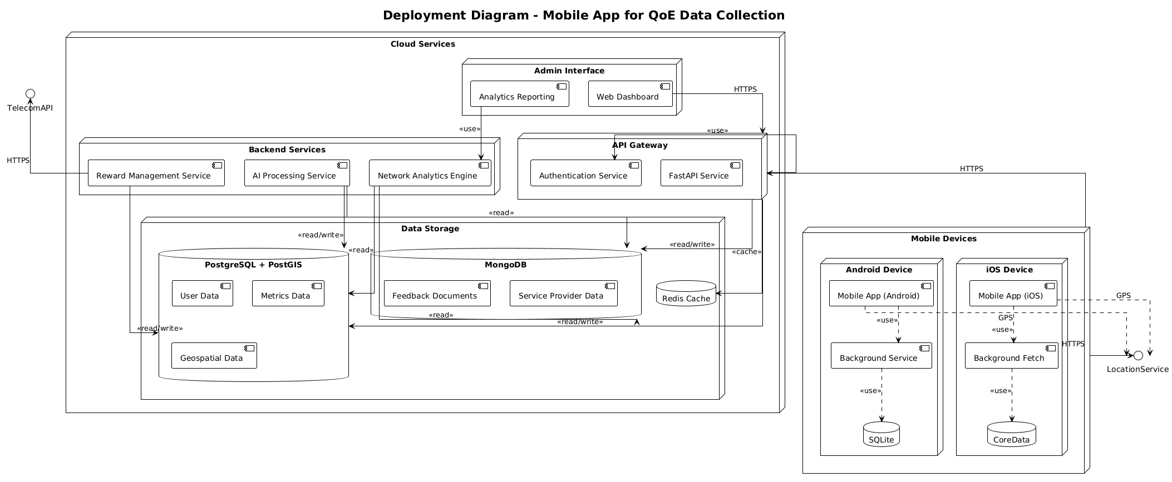
DEPLOYMENT DIAGRAM

